Slide 1
Final Project Update
AA 290 / AA 279D
Ethan LeBoeuf
12/12/19

Slide 2
Contents
Mission Overview
Inertial Simulation
HCW Simulation
YA Simulation
ROE Simulation
UKF
Conclusion
Extra Slides:
Simulink Diagrams
Extra Plots

Slide 3
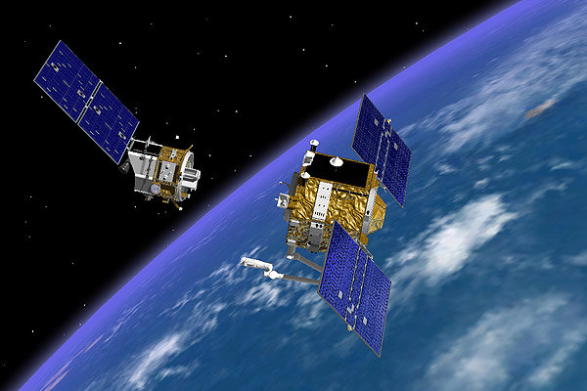
Mission Selection
Name: Orbital Express
Number of Satellites: 2
Type: Rendezvous and Docking
Orbital Express was a DARPA mission to demonstrate rendezvous and docking
One chief, NextSat, and one deputy, Astro
Goal of this project was to mimic as much as possible of this project

Slide 4
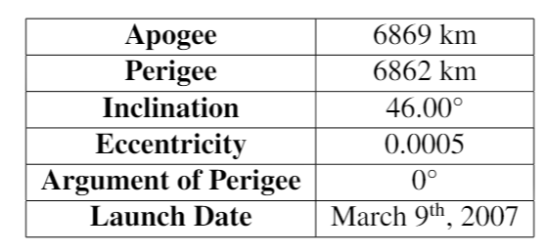
Mission Parameters
Had a near-circular, inclined orbit for the chief
Argument of perigee and RAAN were assumed to be zero as it wasn’t given
Two spacecrafts had equal mass, but deputy had larger surface area (assumed constant throughout the mission)
This will cause the deputy to lose altitude faster at the same velocity as the chief

Slide 5
Inertial Simulation
Started out by doing everything in the inertial space
This included the 3DOF dynamics and the burn calculations
The inertial frame proves to be difficult to work in for calculating burns and was quickly moved away from
The next few slides detail the work done on the 3DOF simulation and the burn calculations done originally in the inertial space

Slide 6
Inertial Simulation - Dynamics
Dynamics were calculated using FODE
Perturbations were introduced to the nominal motion:
J2
Drag
Impulsive burns were used to maneuver the deputy spacecraft

Slide 7
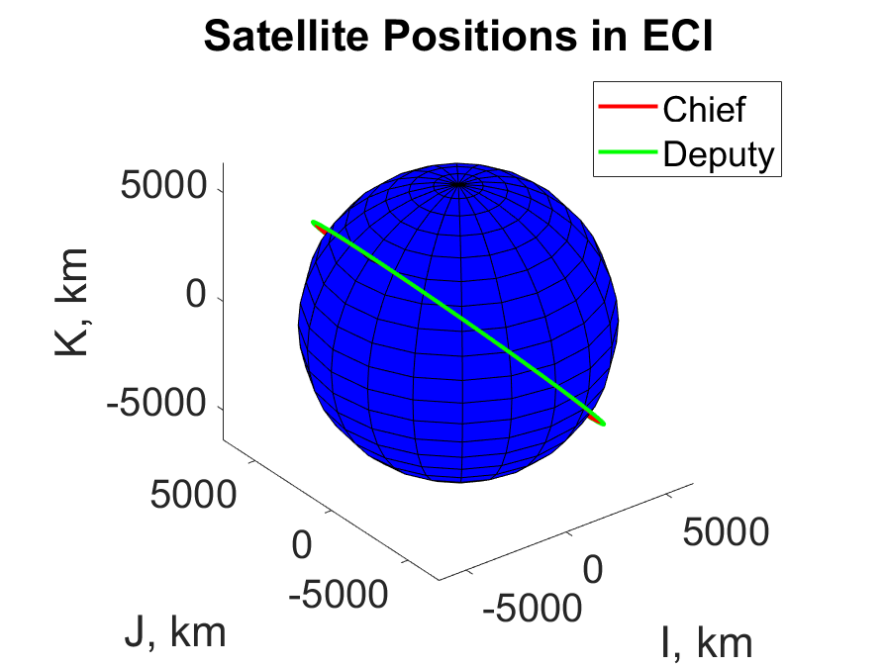
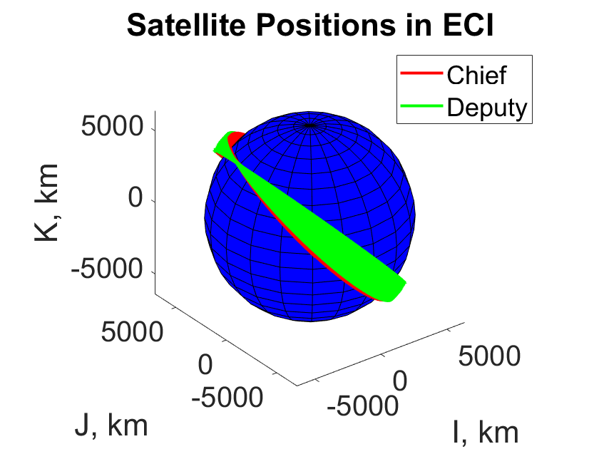
Inertial Simulation - J2
Causes change in right ascension of the ascending node and argument of perigee as expected
No J2
J2 Included

Slide 8
Inertial Simulation - Drag
Computed drag in the ECI frame
Used mass and area of the satellites to compute the inverse ballistic coefficient
Deputy satellite is affected more by drag (larger area) which can be seen in relative position
Drag decreases both semi-major axis and eccentricity

Slide 9
Inertial Simulation – Drag Effects
~Constant
~Constant
~Constant

Slide 10
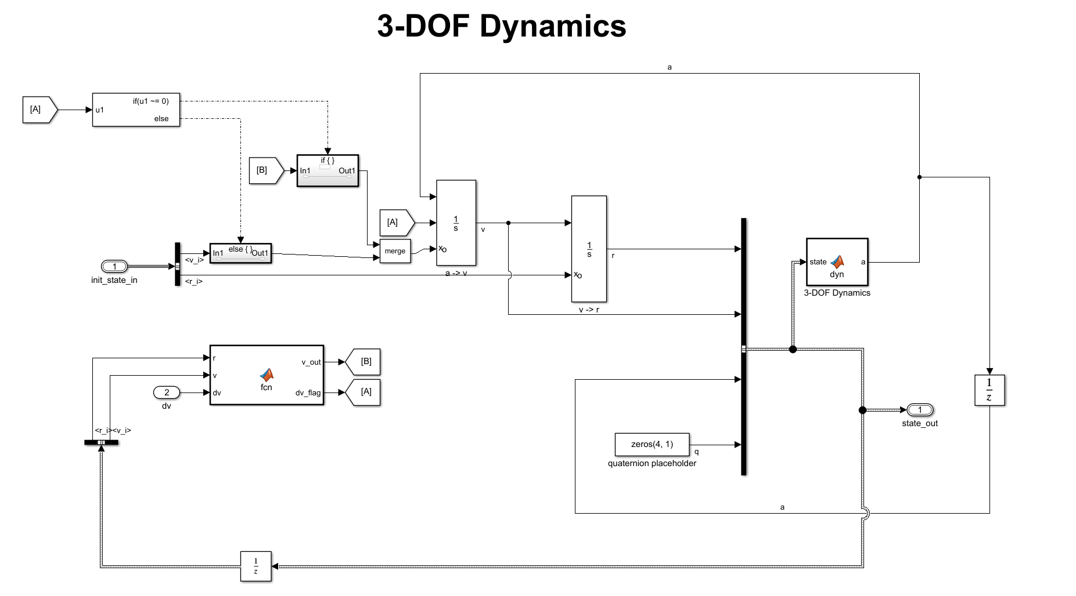
Inertial Simulation – Burn Implementation
For every impulsive maneuver performed, the integrator has to be reset. Adds additional logic to the sim and is more difficult to handle

Slide 11
Inertial Simulation – Bounding Motion
The last steps before moving onto different simulation types (HCW, ROE, etc) was to show maneuvers in the inertial frame
Bounding the relative motion was the first maneuver
Burn Location

Slide 12
Inertial Simulation – Circularizing Orbit
After bounding the motion, I wanted to then show I could circularize the orbit to be able to move between near-circular orbits
Burn Location

Slide 13
Inertial Simulation – Summary
Created a 3DOF Simulation with J2 and Drag
Implemented two maneuver types, but with difficulty continuing this moved to different state representations

Slide 14
HCW Simulation
Made the dynamics use HCW equations to propagate state
Added bounding motion burns and looked at Rendezvous mission in this framework

Slide 15
HCW Simulation – First implementation
Implemented the basic HCW equations
First did so with an IC in the rectilinear frame
As the deputy moves around the orbit, the relative position in the RTN frame becomes hard to interpret
Using an IC in the curvilinear frame allows the HCW equations to propagate the curvilinear state giving more reasonable results for equivalent starting conditions
Rectilinear Frame
Curvilinear Frame

Slide 16
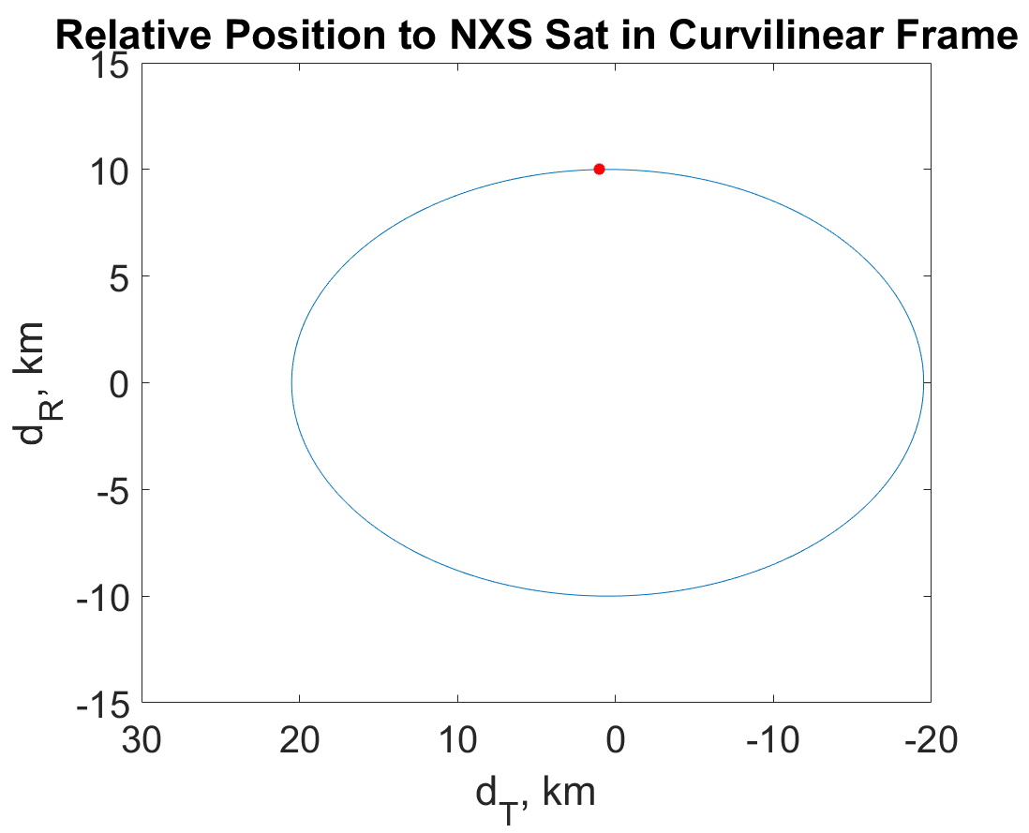
HCW Simulation – Bounding Motion
Similar to the inertial simulation where the semi-major axis needs to be set, the velocity in the along-track direction needs to be set to bound the motion

Slide 17
HCW Simulation – Rendezvous Mission Framework
Targeting specific positions is fairly easy in the HCW equations when compared to inertial coordinates
Inputs: Desired position in the relative frame, time of transfer orbit (nt)
Then using the linearized equations, the simulation can calculate the dV needed to change the course of the deputy to reach the desired position
The motion of moving between desired positions is helpful for the planning of the rendezvous mission
Much easier to design the mission in this framework than in inertial sim, but no J2 or drag so if burns were implemented in true 3DOF simulator it would not work nearly as well

Slide 18
HCW Simulation – Summary
HCW equations were easy to program, however, not being able to account for J2 or drag easily leads to large problems down the road
Burn directions and magnitudes were easy to calculate for both bounding motion and for waypoint movement

Slide 19
YA Simulation
Implemented YA equations
Didn’t implement moding or burn calculations with YA to allow for more time with ROEs

Slide 20
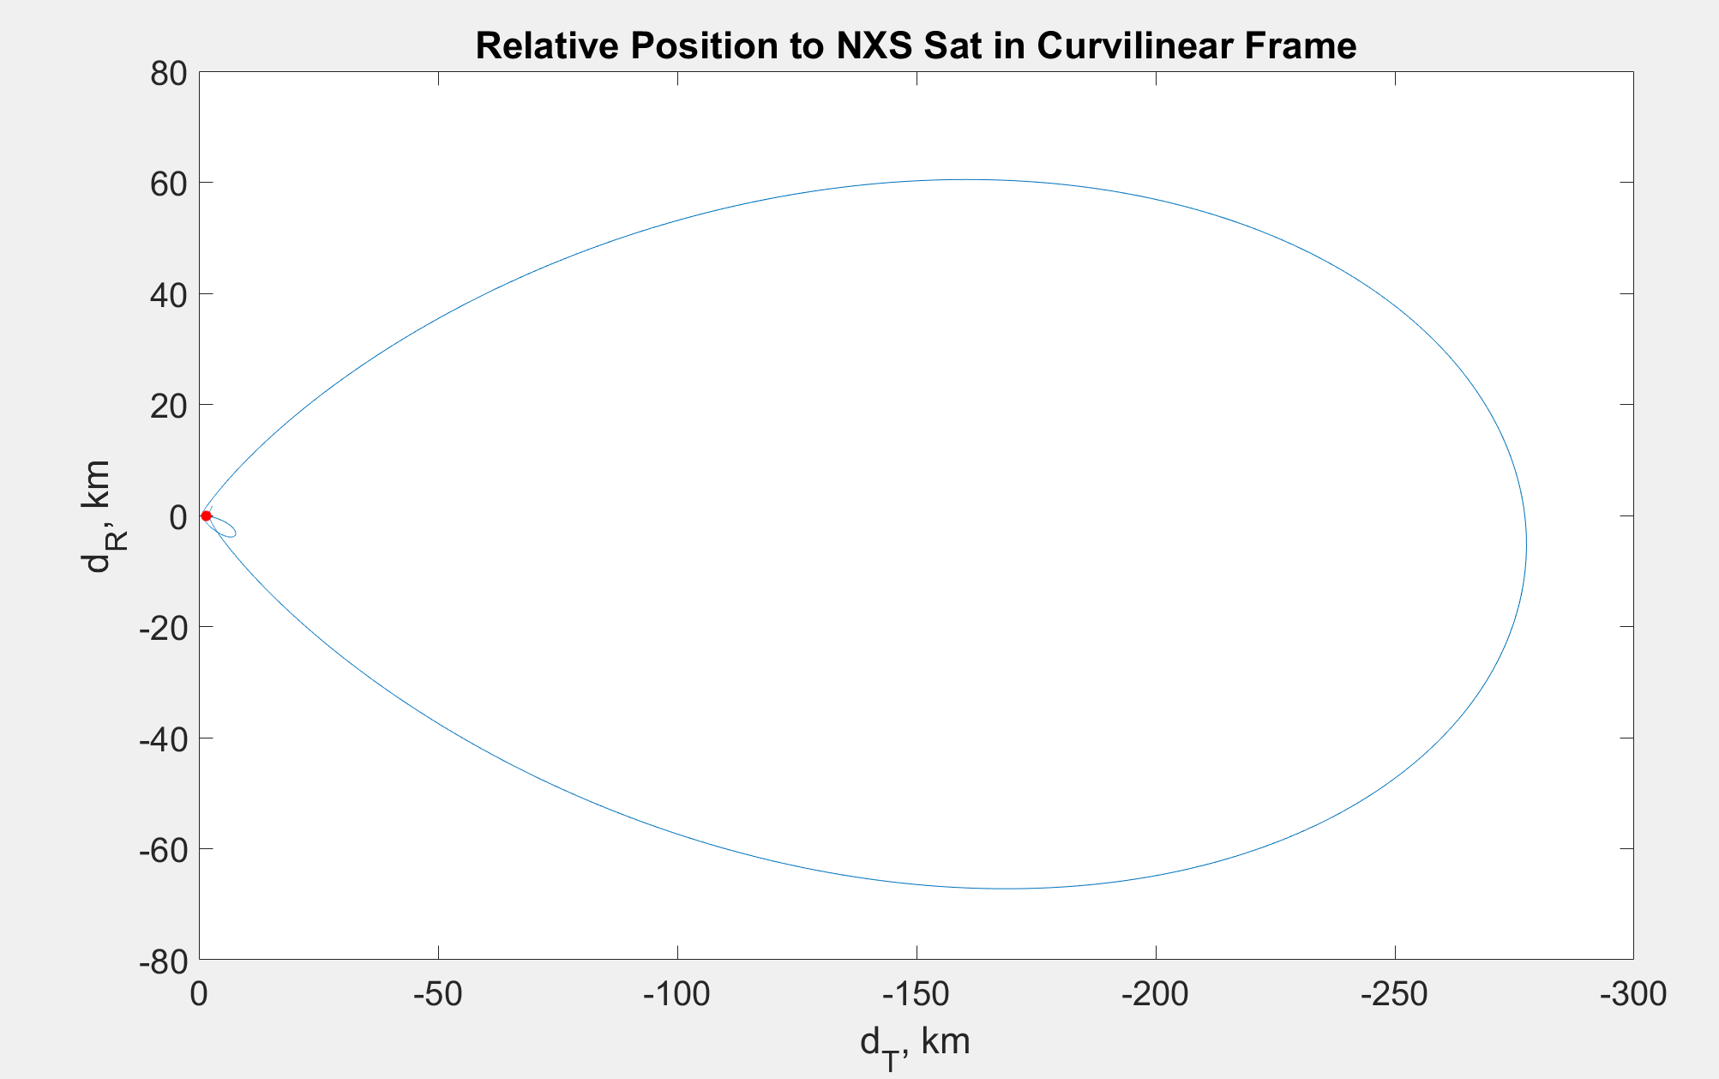
YA Simulation – Dynamics
Propagating dynamics using YA state matrix results can be seen below
Used an example from a book to confirm results

Slide 21
ROE Simulation
Propagated dynamics in the inertial space
Implemented ROE propagation in the “Computer” block of my simulation
Used this for burn calculations and moding choices

Slide 22
ROE Simulation – Propagation with J2 considered
Implemented STM accounting for J2 without small angle approximation results were as expected:

Slide 23
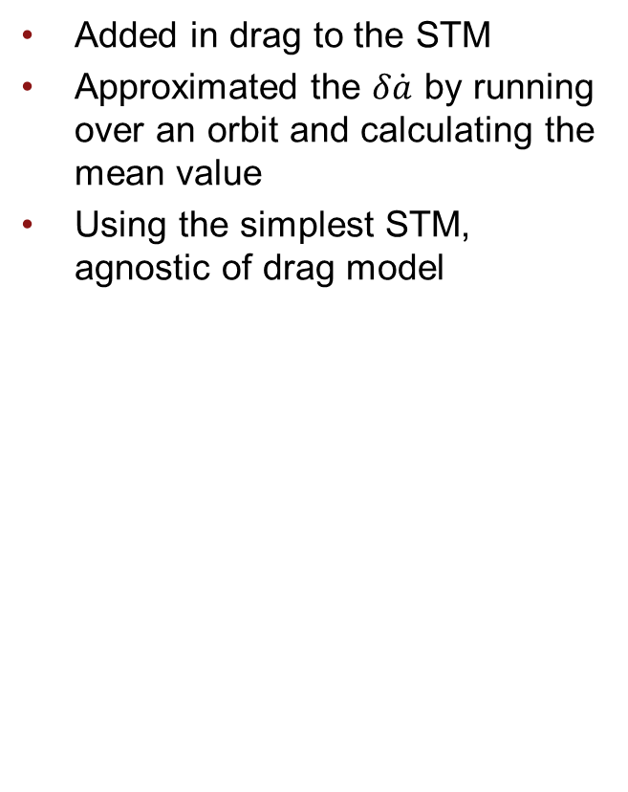
ROE Simulation - Drag Implementation
Added in drag to the STM
Approximated the $δ\dot{a}$ by running over an orbit and calculating the mean value
Using the simplest STM, agnostic of drag model

Slide 24
ROE Simulation – J2 and Drag

Slide 25
ROE Simulation – Bounding Motion
Calculate the bounding burn using ROE now → just looked at da, not accounting for changes in other ROEs

Slide 26
ROE – Guidance for Overall Mission
Start above and ahead
Come to intermediate orbit, 0.5 km rbar
Come down to 0 km rbar and
Vbar maneuvers to rendezvous → moding is set up but calculating burns not done

Slide 27
ROE – Guidance for Overall Mission Cont.
Currently in position to start terminal guidance but ran out of time
Wasn’t able to achieve the final portion of the mission

Slide 28
ROE Simulation - Summary
Was able to maneuver the deputy spacecraft to the point where terminal guidance could be initiated
Calculated burns using the ROE space
Was unable to complete the terminal guidance to finish the rendezvous and docking

Slide 29
UKF
Used a UKF for the navigation on this project
Currently have a “sensor” that returns noisy relative position and velocity
Use UKF to estimate the ROEs
Propagate them with the full STM
Measurement model is currently changing ROEs to relative position and velocity

Slide 30
UKF Results
No Burns
With Burns

Slide 31
UKF
UKF was able to track the given state and allow for burns to be calculated accurately by giving ROEs to the guidance block

Slide 32
Conclusion
I was able to look at various state representations in the context of the Orbital Express mission
Inertial guidance proved to be the most difficult to deal with as burn calculations were not easy to formulate
HCW equations gave easy burn calculations but did not allow for perturbations to be taken into account
ROE state representation gave the best framework to calculate burns
Was able to include navigation in the form of a UKF to estimate the true state
Unable to finish the terminal part of the mission

Slide 33
Overall Simulation
I have included images of my final Simulink diagram on the next few slides

Slide 34
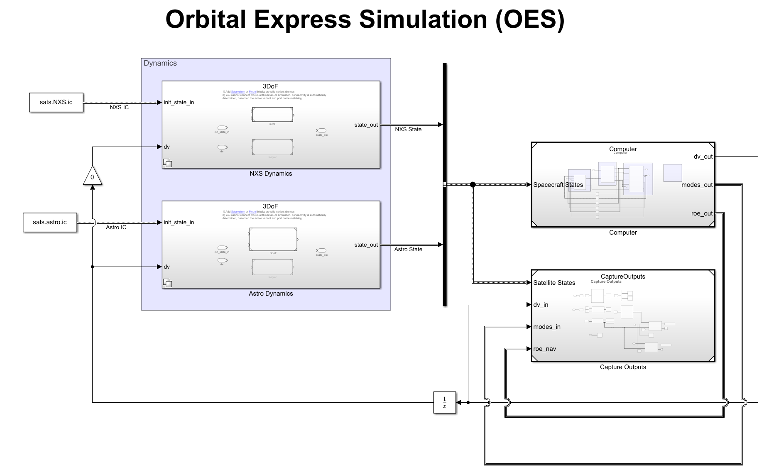

Slide 35
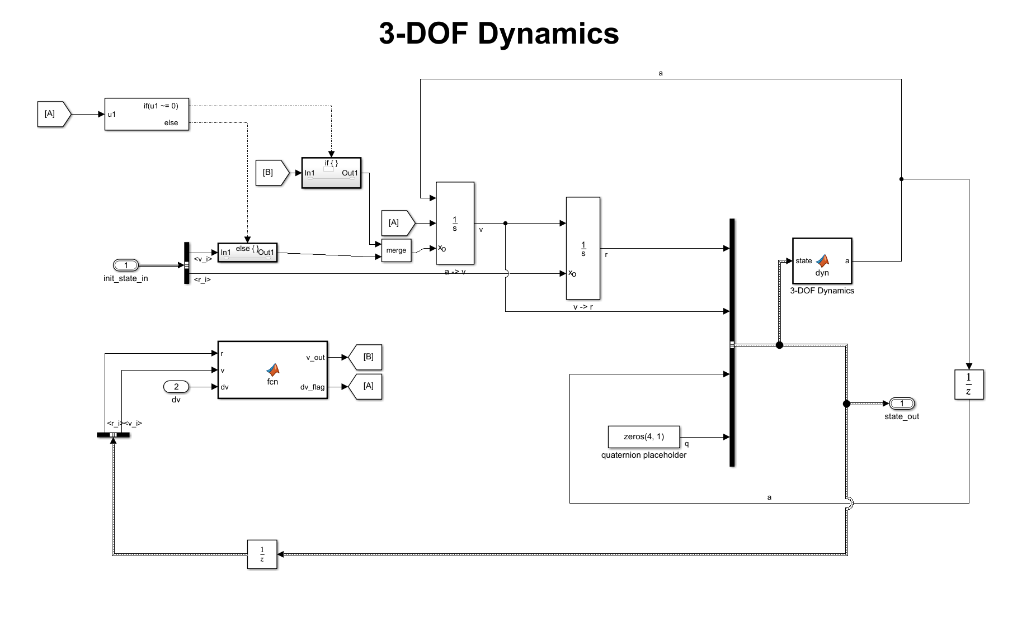

Slide 36
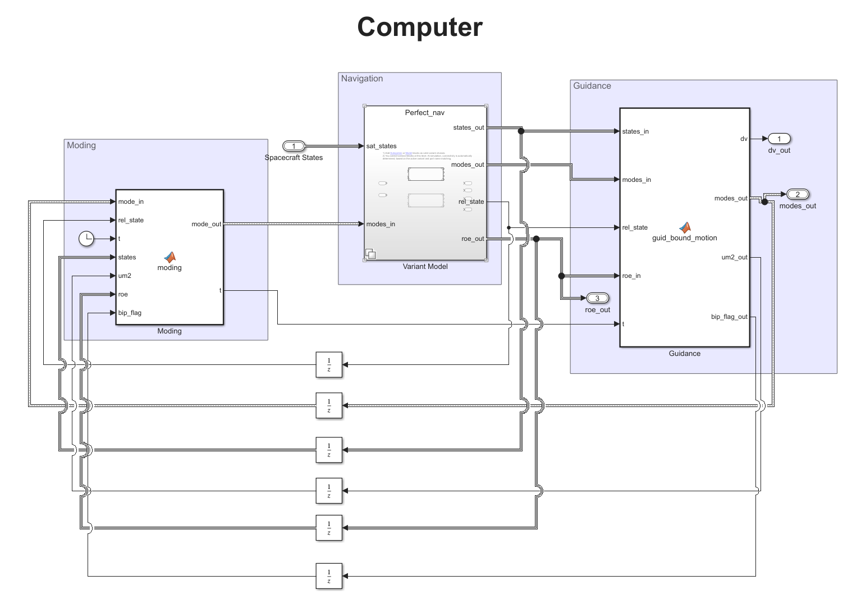

Slide 37
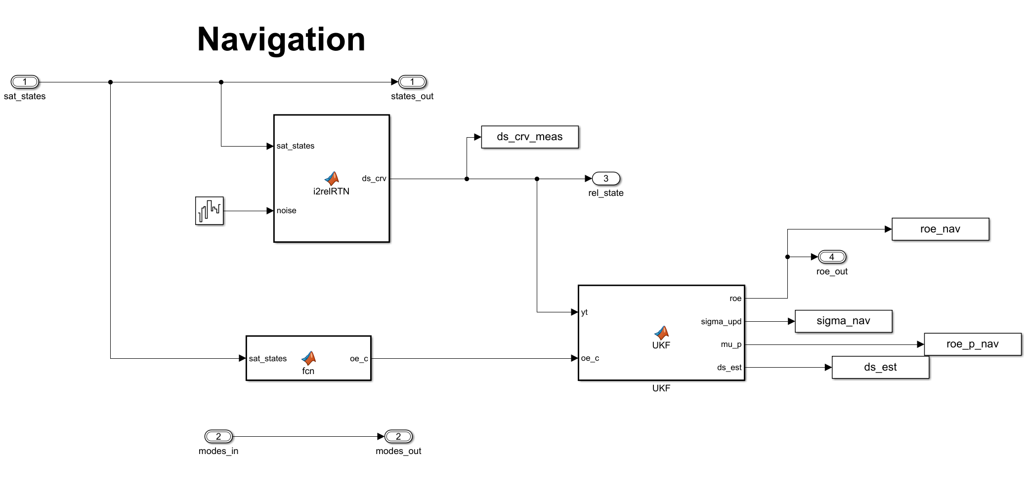

Slide 38
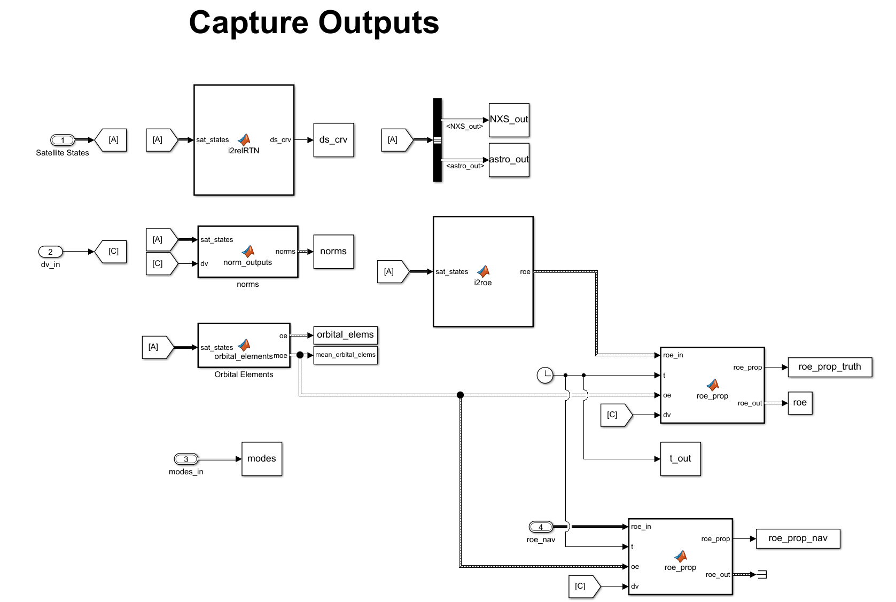

Slide 39
Backup Images of Final Run

Slide 40
